Slide 1
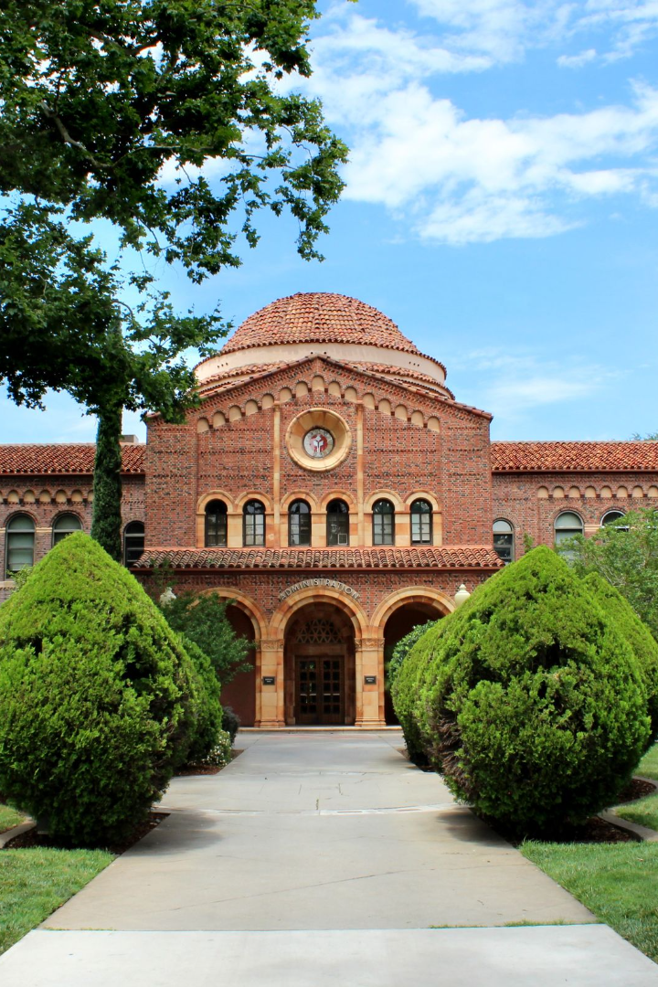

USA Edu Fair 2023
Elevate your future with Career Bridge Group at CSU – Cleveland State University!
Join us on Nov 25th for virtual excellence – #1 in National Research, Top-tier Engineering, High-Rank STEM, and more!
Register here - https://careerbridge.in/events-for-the-month/usa-edu-fair-2023/114

Slide 2

About USA Edu Fair 2023 sponsored by Career Bridge Group
Discover the world of opportunities that await you at the USA Edu Fair 2023!
Gain insights into top universities, scholarships, and study abroad programs.

Slide 3


Event Date and Venue
Save the date! The USA Edu Fair 2023 will be held on November 25th. Join us virtually from anywhere in the world to explore your academic options.
Register here - https://careerbridge.in/events-for-the-month/usa-edu-fair-2023/114

Slide 4

Registration Details
Secure your spot at the USA Edu Fair 2023 by registering online. Don't miss out on the chance to connect with renowned universities and access valuable resources.
Register here - https://careerbridge.in/events-for-the-month/usa-edu-fair-2023/114

Slide 5

Introduction to Career Bridge Group
1
A Trusted Guide
Career Bridge Group is dedicated to helping students navigate the path to success through personalized guidance and support.
2
Comprehensive Solutions
With our range of services, we provide students with a holistic approach to achieve their academic and career goals.
3
Expert Guidance
Our experienced counselors and advisors are committed to helping students make informed decisions for a brighter future.

Slide 6
Achievements and Rankings
#1 in National Research
Top-tier Engineering
Be part of a university that is at the forefront of groundbreaking research, pushing boundaries and creating real-world impact.
Experience world-class engineering education, supported by state-of-the-art facilities and renowned faculty.
High-Rank STEM
And More!
Immerse yourself in cutting-edge science, technology, engineering, and mathematics programs to meet the demands of future industries.
Explore additional rankings and accomplishments that position our institution as a leader in various fields of study.

Slide 7



Highlighted Programs
Academic Excellence
Diverse Community
Research Opportunities
Discover a wide range of undergraduate and graduate programs designed to meet your academic interests and career aspirations.
Immerse yourself in a vibrant and inclusive campus environment that celebrates diversity and fosters collaboration.
Engage in groundbreaking research projects alongside renowned faculty, gaining hands-on experience and making a difference.

Slide 8


Benefits of Joining Career Bridge Group
1
Personalized Support
Receive individualized guidance and support throughout your educational journey, ensuring you achieve your goals.
2
Networking Opportunities
Connect with industry professionals, alumni, and fellow students, creating valuable networks for future career endeavors.
3
Internship and Job Placement
Access internship and job placement services that facilitate your transition from student to professional.

Slide 9

Closing Remarks and Contact Information
Thank you for considering Career Bridge Group at CSU. For more information, visit our website or contact our admissions team to begin your journey to success.
Website: https://careerbridge.in Address: Flat No 206, Riviera Apts, Behind Model House, Dwarakapuri Colony, Punjagutta, Hyderabad, Telangana 500082 Email: connect@cbgroup.in Phone: +91 9948 66 22 55 and 040-48520250

